Slide 1
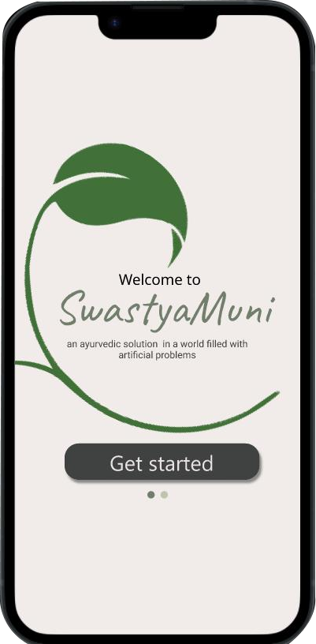
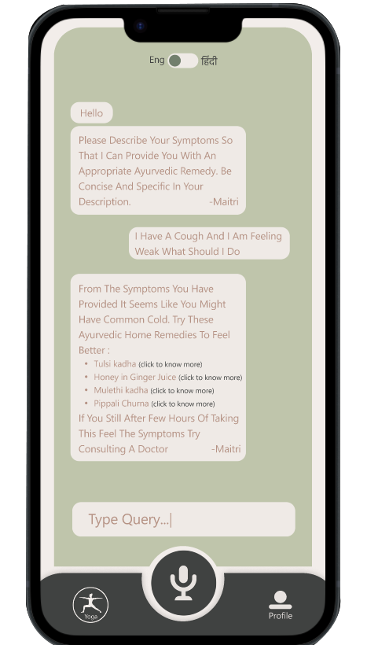


SwastyaMuni
An ayurvedic solution in a world filled with artificial problems
What SwastyaMuni Achieves
Ancient Wisdom Made Accessible: SwastyaMuni offers easy-to-understand Ayurvedic principles and guided yoga practices.
Cultural Heritage Revival: It reconnects users with their cultural roots, preserving traditions while promoting balance and diversity in modern life.
Holistic Health Benefits: SwastyaMuni combines Ayurveda and yoga to improve overall health and well-being, conveniently delivered through AI.
HEXORA

Slide 2

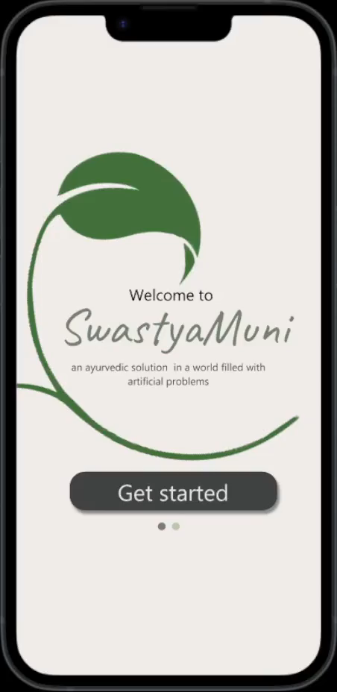
Here is the Video demonstrations of the Features listed below
The first ever Personalized AI Ayurveda Chabot trained on ancient books on Ayurveda
Disease prediction and Ayurvedic remedies
Body type predictions and fitness routine recommendations
Yoga asan recommendations and alignment assessment
MultiLingual support
Binaural beats to help you focus and lighten up your mood
Spreading awareness about Ayurveda and yoga's among the youth

